Slide 1
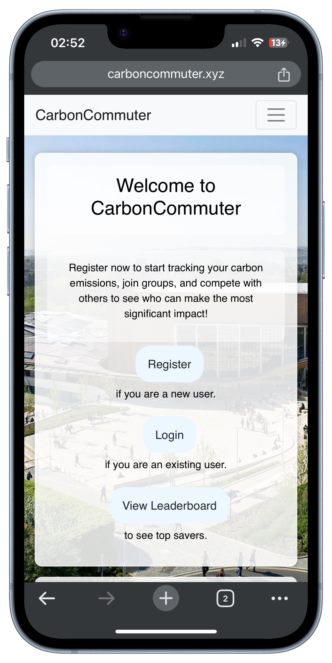


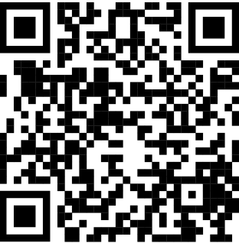
The Ceiling Fans
Abigail Hinton, Sam Townley, Giulia Brown, Charles Symonds, Eleanor Forrest & Jack Skinner
Record
A users commute
CarbonCommuter allows you to record your journey to and from campus via your device’s location services.
Badges + Leaderboard
CarbonCommuter has a Leaderboards where you can see the top savers, the best groups and compete for the top spot. The top savers will even earn rare badges.
Compete
With Friends and Societies
CarbonCommuter allows you to follow your friends, join groups and participate in events.
Gamify
More sustainable Journeys (Bike/Walk) have greater savings!
You can view your group and friend's progress.
More people taking sustainable journeys
Less greenhouse gas emissions caused by students
University closer to net zero goal
Breakdown of Transport Usage by Students/Staff at University
Students
Staff
~30% of University staff drive to campus. Assuming an average distance of 3km each way, switching to cycling could save a Ton of Co2 every day
Sustainable
If CarbonCommuter encourages even 5% of students to make more sustainable journeys, This could add to Tons of Co2 not being emitted to our atmosphere
Approximately 60% of students cycle or walk. Getting this figure to 100% would save approximately 1.5 Tons of Co2 a day!
*Figures taken from similar UK university. All calculations are approximations
CarbonCommuter Website
https://www.carboncommuter.xyz

